Slide 1

GO
Mirai Toire
Project:Terminal Application
未来 トイレ
An adventure game that started out with huge ambitions that never came to be

Slide 2
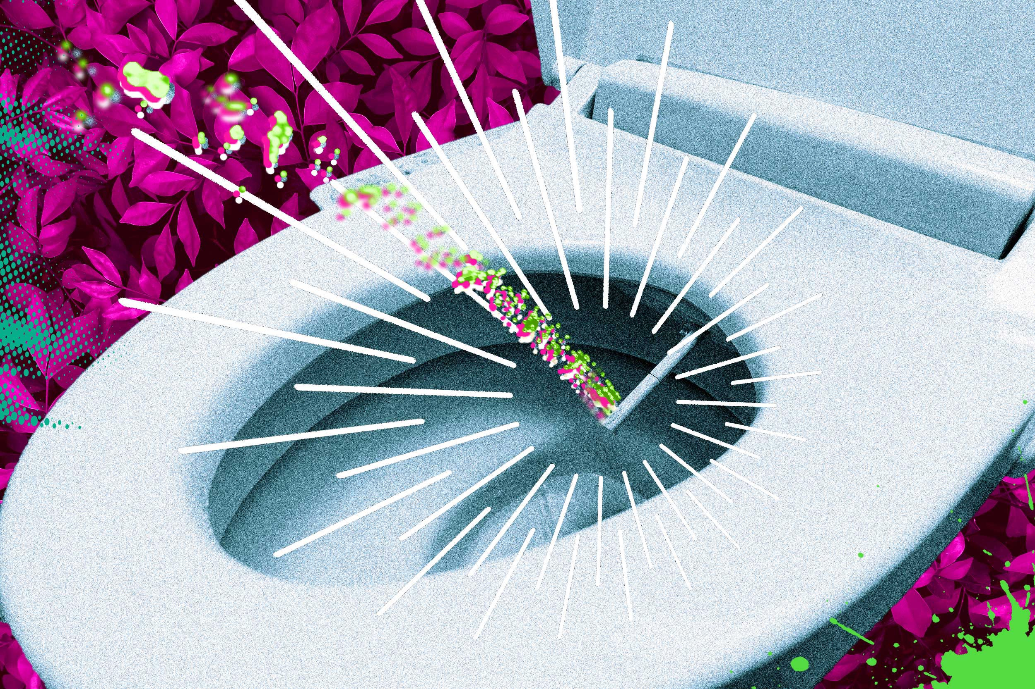
Mirai Toire GO
未来 - Future トイレ - Toilet

Slide 3
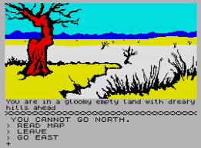
Adventure games are hard...

Slide 4
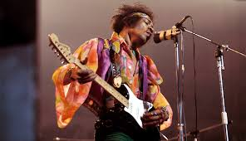
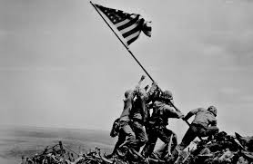
Originally....
My initial goal was to create an experience like no other. The idea was that you were someone waking up in a room, unsure of how you arrived there. The only thing available to you is a weird looking toilet. Sitting on the toilet and leaving a desposit sample would allow you to travel anywhere in any time or place.
That meant that you could travel to West Germany during World War 2. Or travel and meet The Beatles or Jimi Hendrix at Woodstock. But it wasn't mearly travelling to those locations, but you could type anything and a fairly correct response would be returned.
None of this 'can't understand this command'.
The reason for this was a test for the human condition, and allow people to do anthing that might seem uncouth. Such as going back and kidnapping baby Jesus.

Slide 5
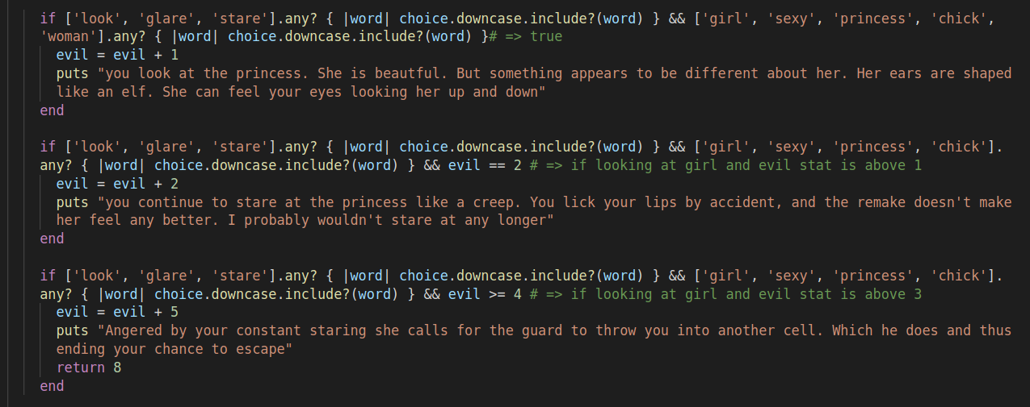
|
if statements
Most of the heavy lifting is done with 'if' conditions. When the user enters a statement it will check whether the word matches in the array.
the downcase allows the user to enter both uppercase and lowercase and the condition will still be true.
In this example, I have also included a stat system depending on what the player enters.

Slide 6
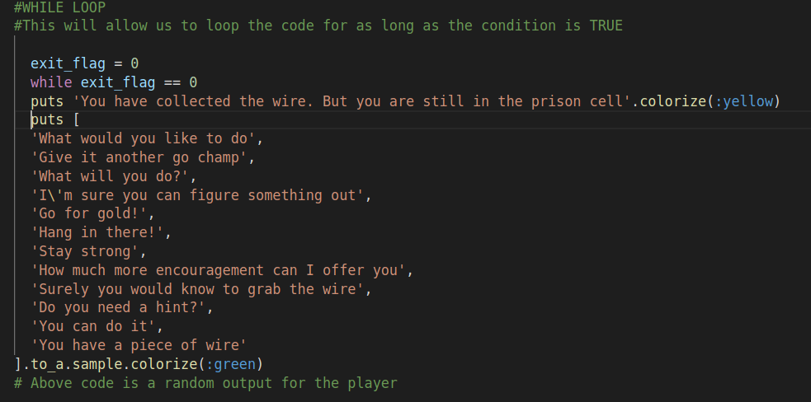
|
random statements
Some of the code features random features such as dialogue.
This example shows 'sample' being called on an array, which randomise the output
Another feature was never ended up was the rand(i) function that can output a random number ie rand(5) => random number from 0 to 5

Slide 7
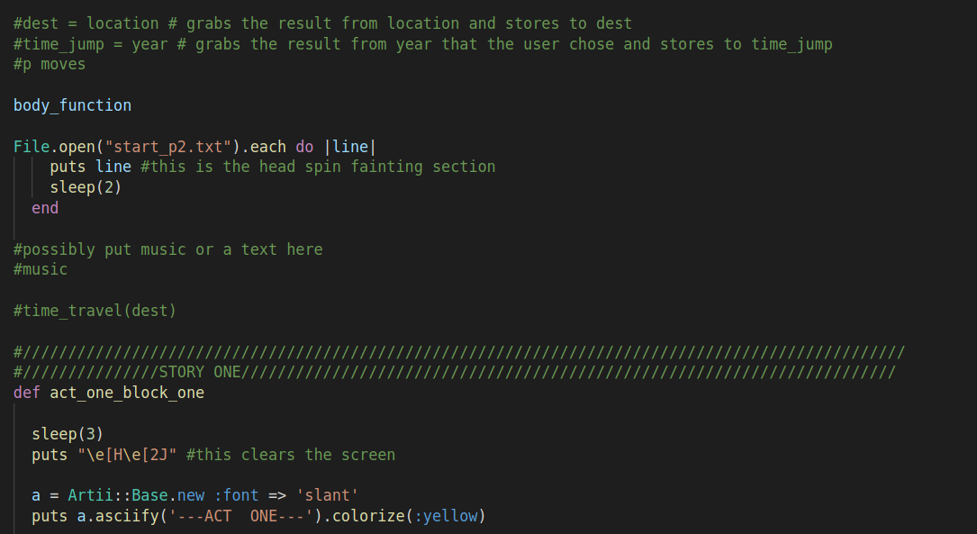
|
importing of external docs
Importing text files and using them instead of type out lines of code. Would also help with creating ascii art in a text document
sleep(3) is a neat feature that can helps the flow of the program
puts “\e[H\e[2J” clears the screen. Yep, had to google that one

Slide 8
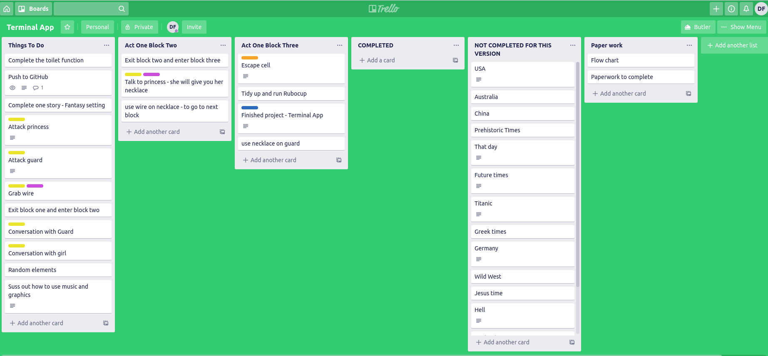
|
Planning and project managment helped a lot to work out what I needed to complete.
I found Trello too limited for what I wanted to do though, as it would be nice to have more options in setting flags. Though more time in the program would be needed
Planning Project Managment

Slide 9
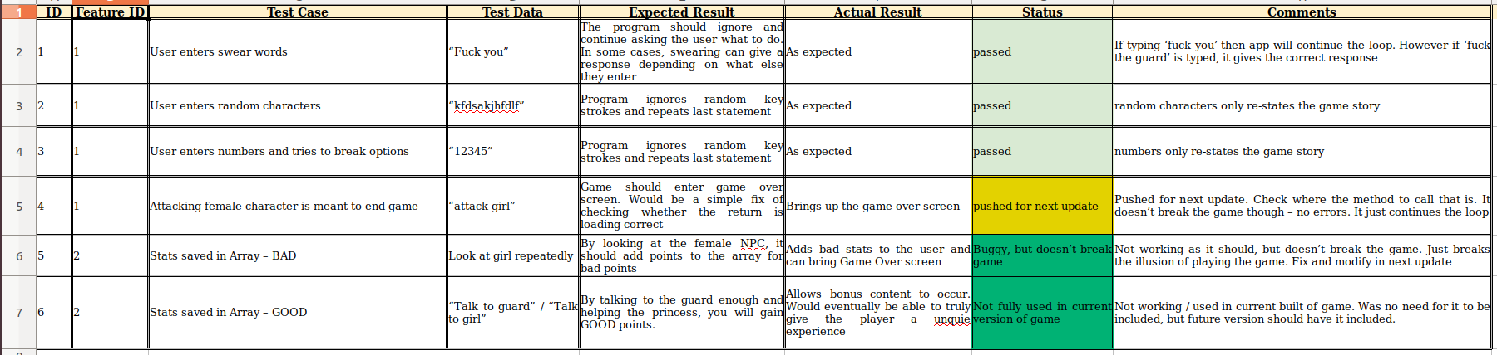
|
Manual Error Checking
Manual error checking

Slide 10
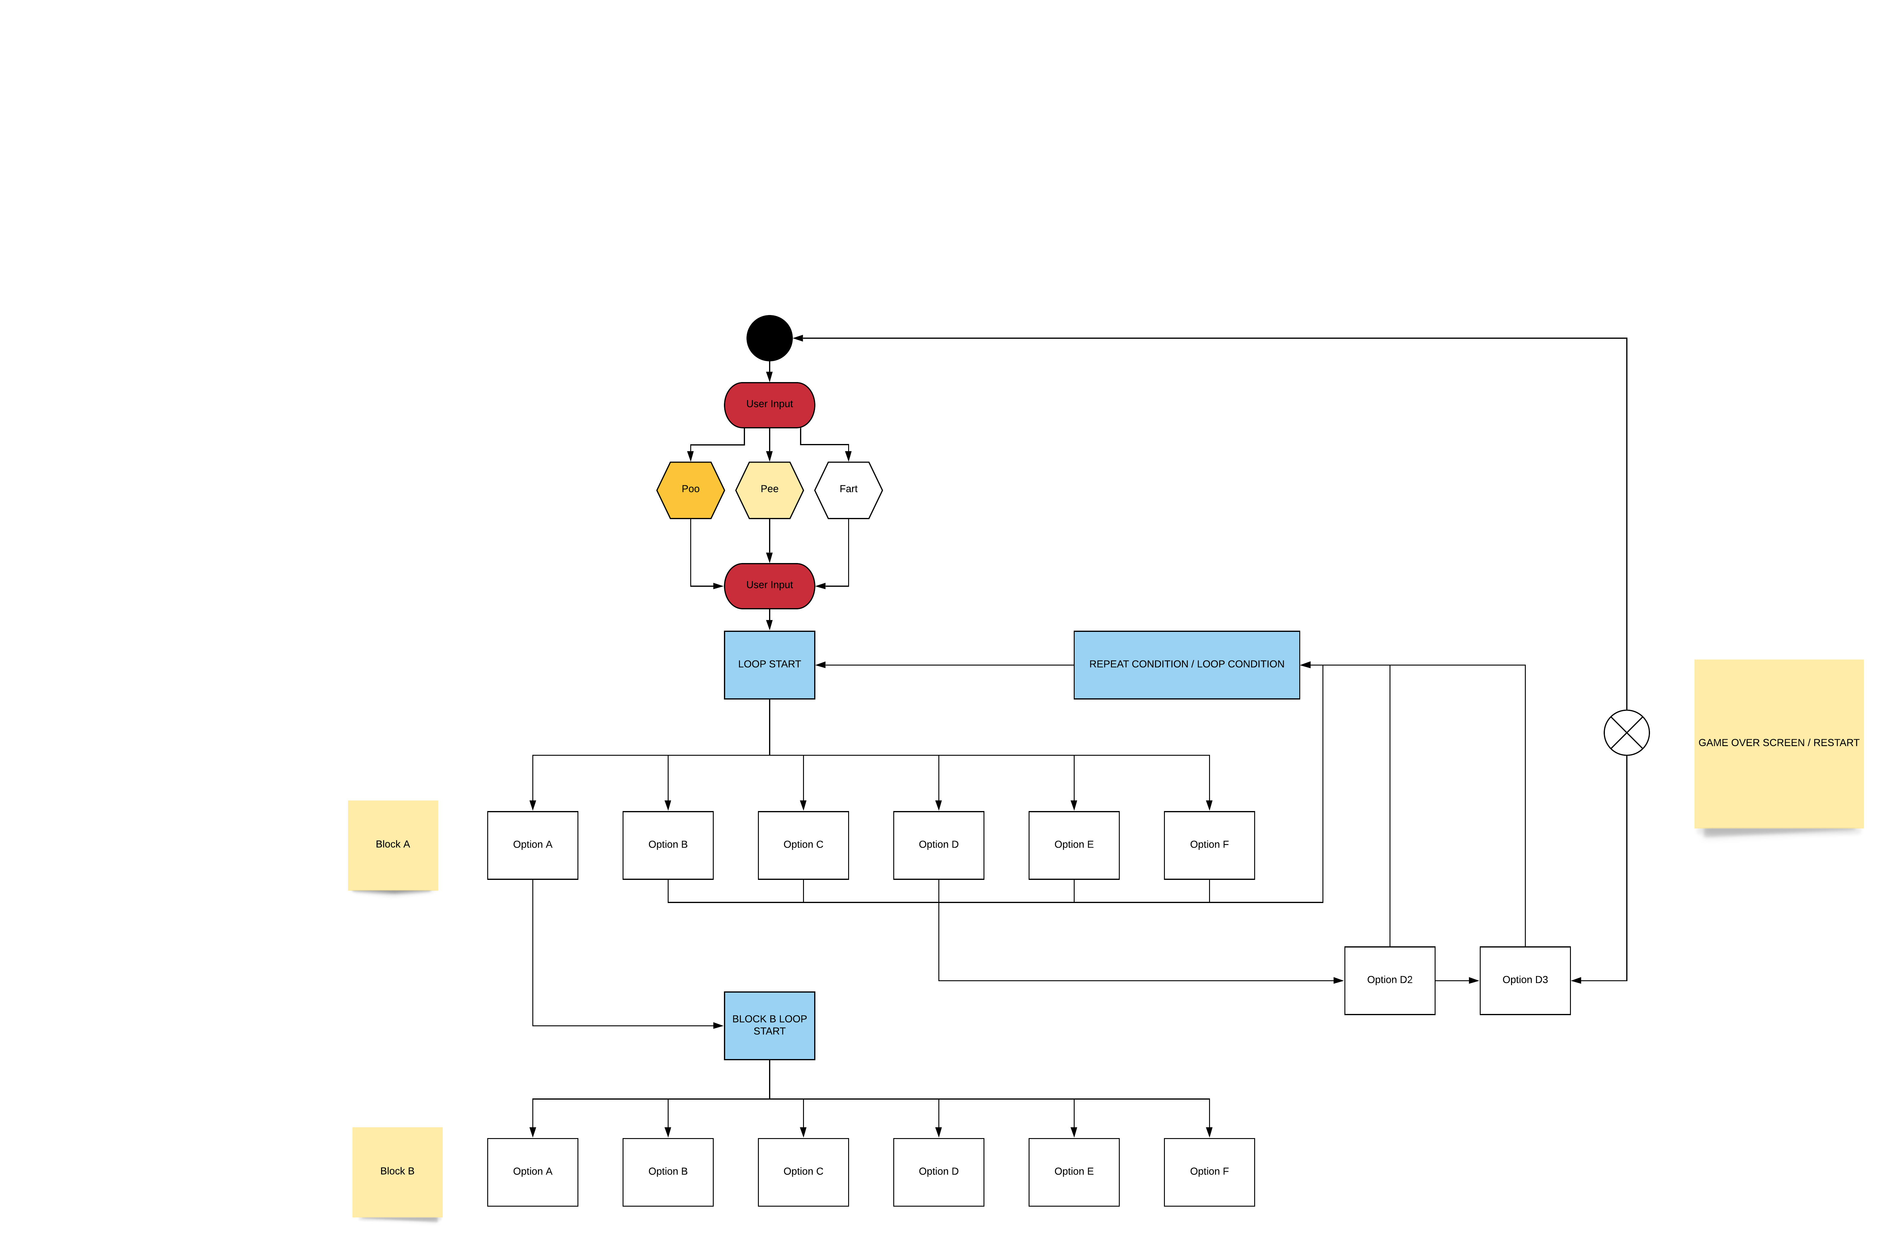
|
UML
UML / Flow Chart of the process / control flow.
In the program there are blocks. Like mini levels within the one level. As the player chooses the correct option it loads in the next block. If not, then the loop continues until the 'exit-flag' has been selected

Slide 11
Thanks. Hope to see you in the future..
(or the past.)

